Slide 1
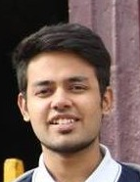
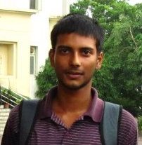
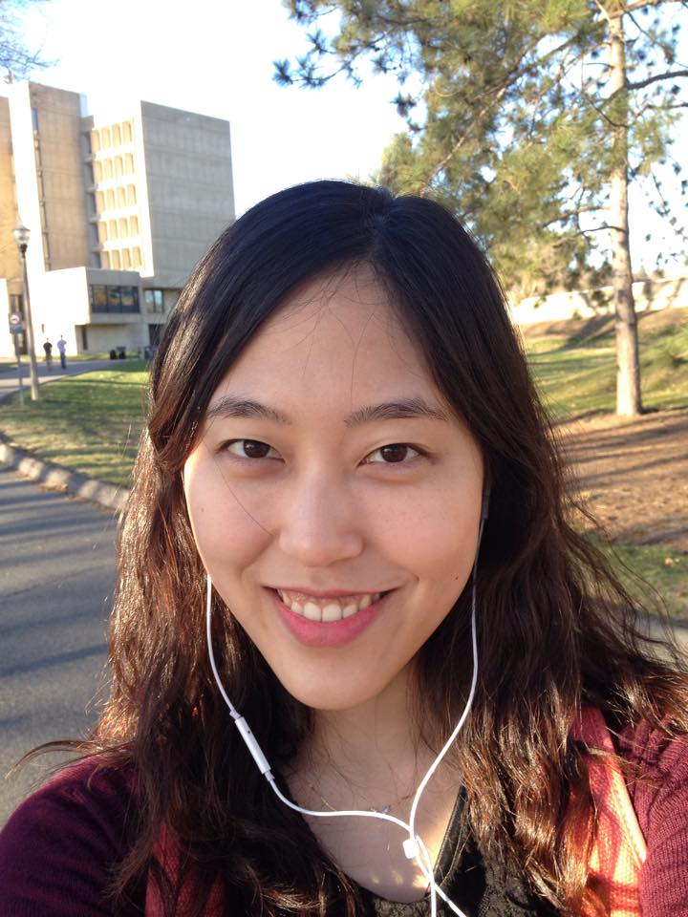
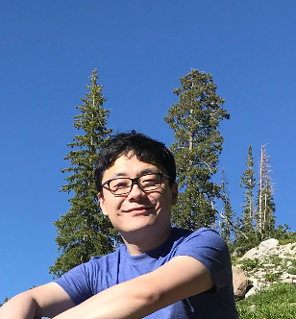
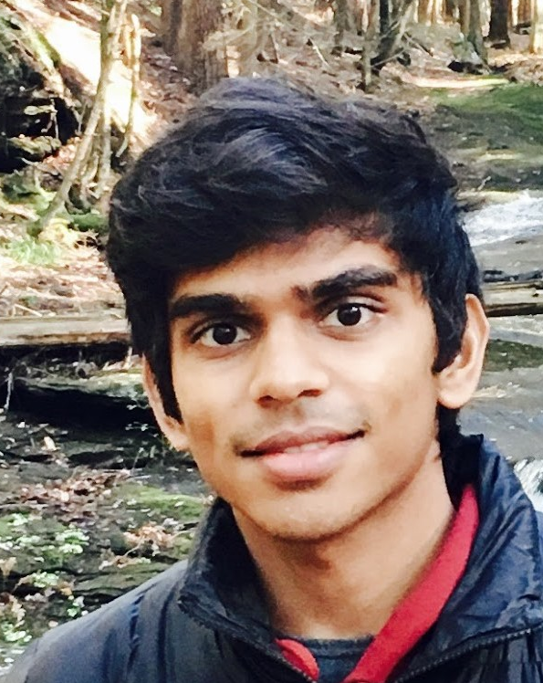
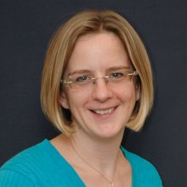
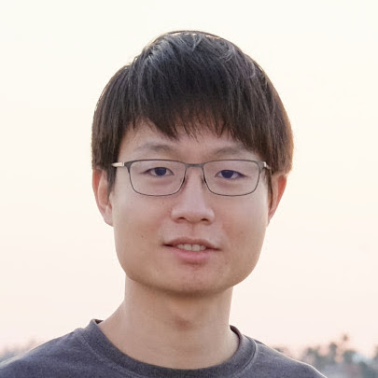
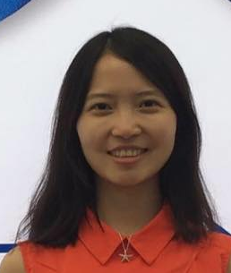
The Half&Half Benchmark: Recognizing What You Cannot See
Erik Learned-Miller
College of Information and Computer Sciences

Slide 2
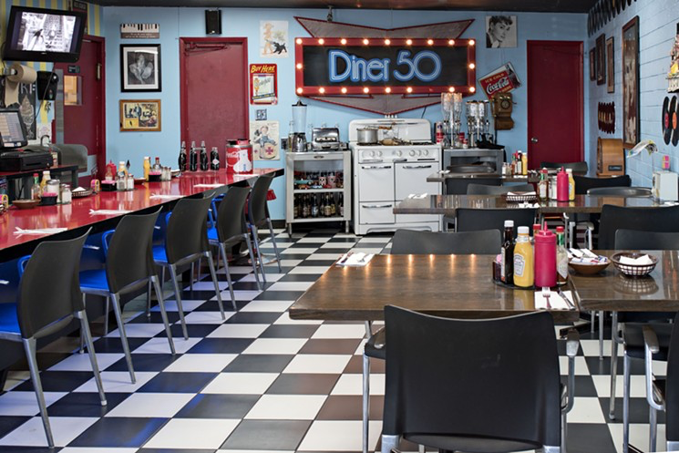

Slide 4
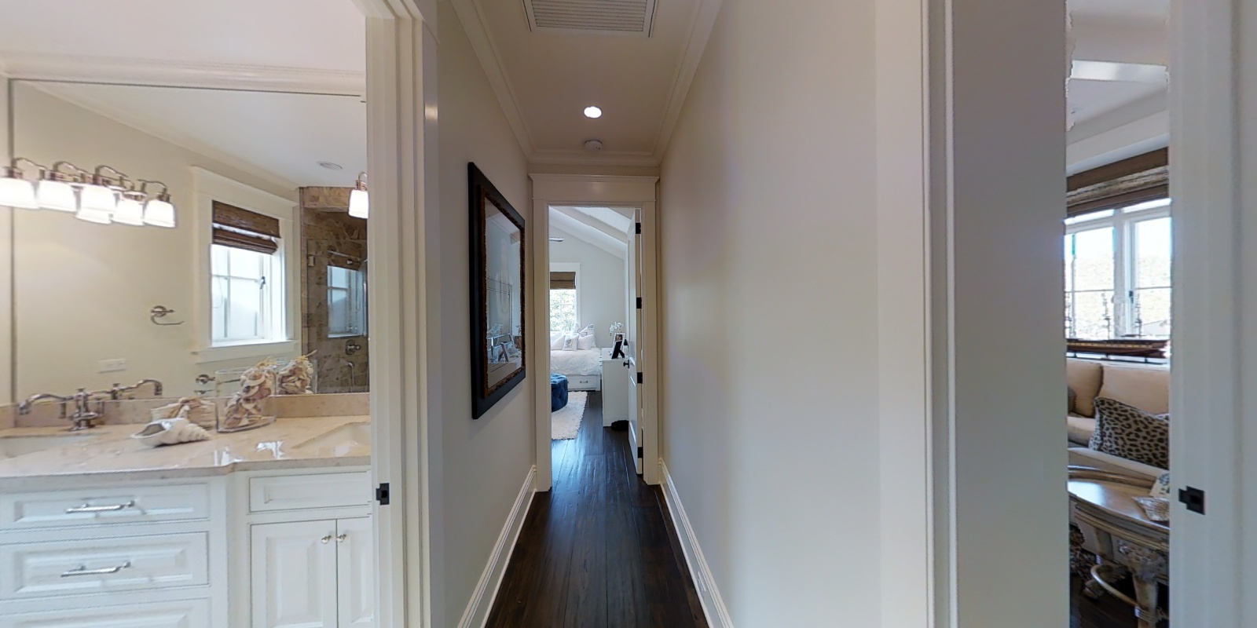
Goal: “Find a TV”

Slide 5
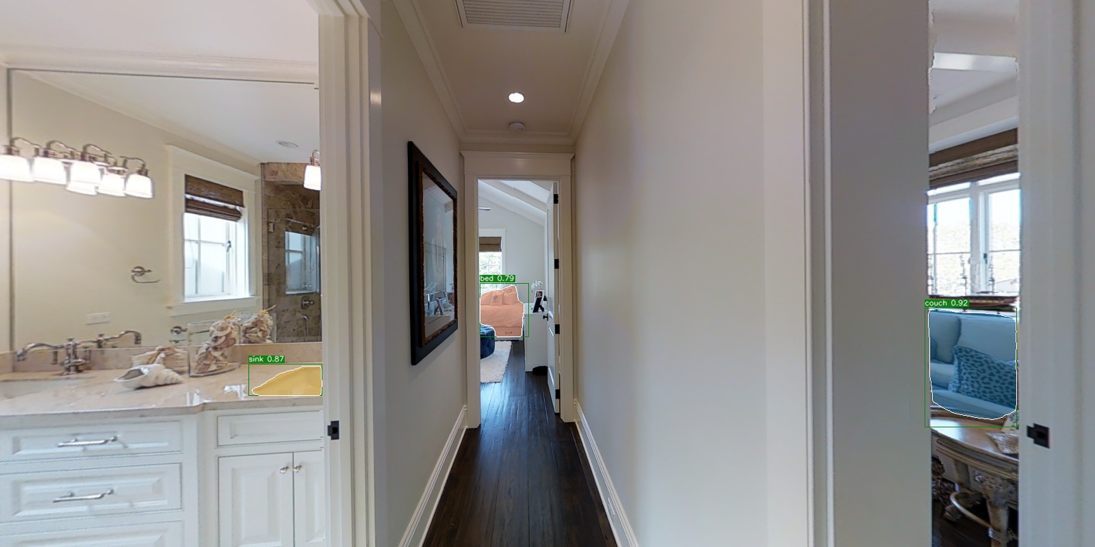
Three directions with detected objects
Left: sink
Front: bed
Right: couch
bed
couch
Since TV co-occurs more often with couches, let’s explore right first!
sink

Slide 6
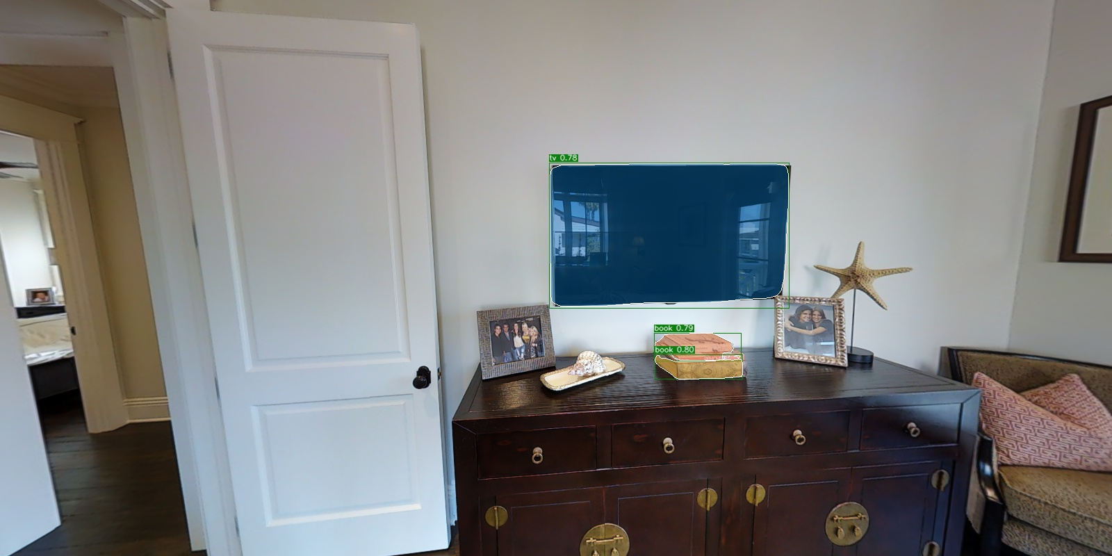
Voila!
A TV is found!
tv

Slide 7
Goals of this research
Develop methods for “Intelligent search”
Leverage the “Trail of Breadcrumbs”
Prediction of what we cannot see

Slide 8
Half & Half Benchmarks

Slide 9
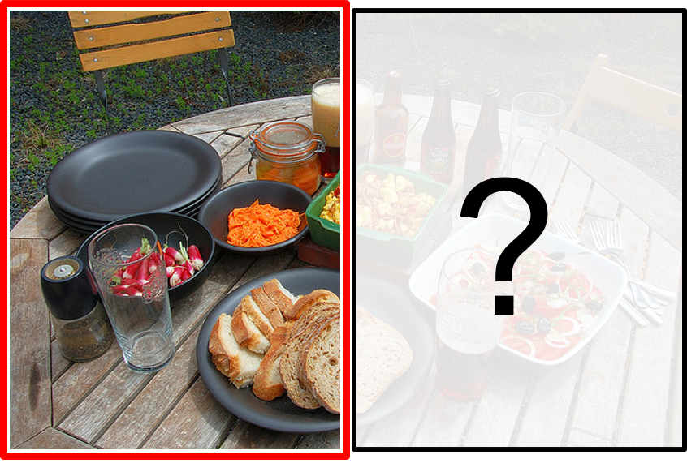
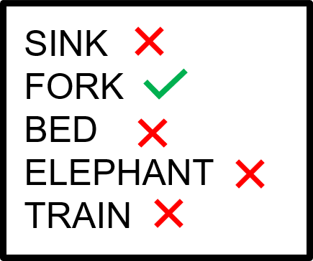
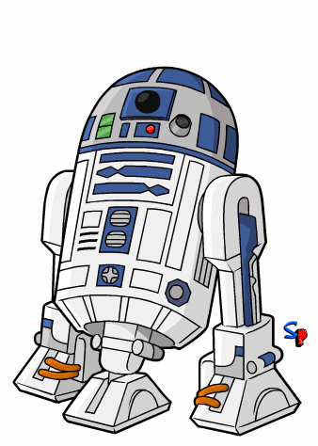
Half&Half Image-to-Label

Slide 10
Half&Half Image-to-Label

Slide 11
Dataset Details
Images taken from MS-COCO Dataset (training and validation split)
Train: 35,843 images
Training split : 32,000 (unique) images
Validation split: 3,843 images
Multiclass classification ⇒ Training split (with duplication): 47,370 images
Test: 10,000 images
Correct candidate randomly chosen from objects present in the right half
Incorrect candidates chosen from categories not present in whole image

Slide 12
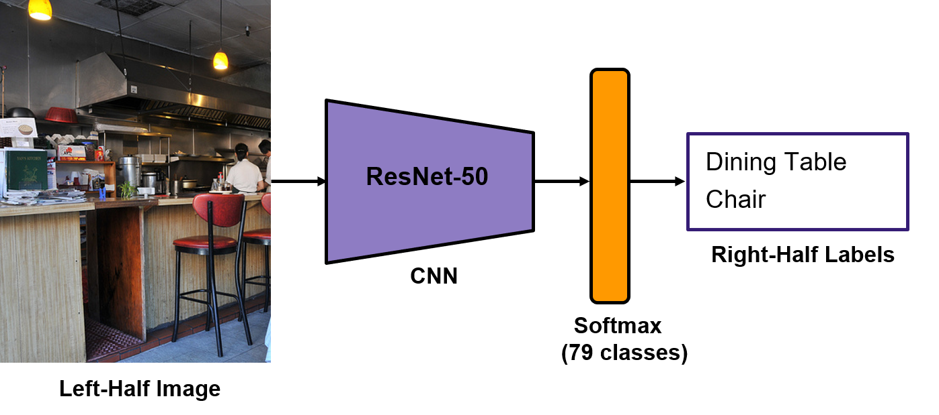
Training
End-to-end learning of visual context
“Anti-symmetric classifier”

Slide 13
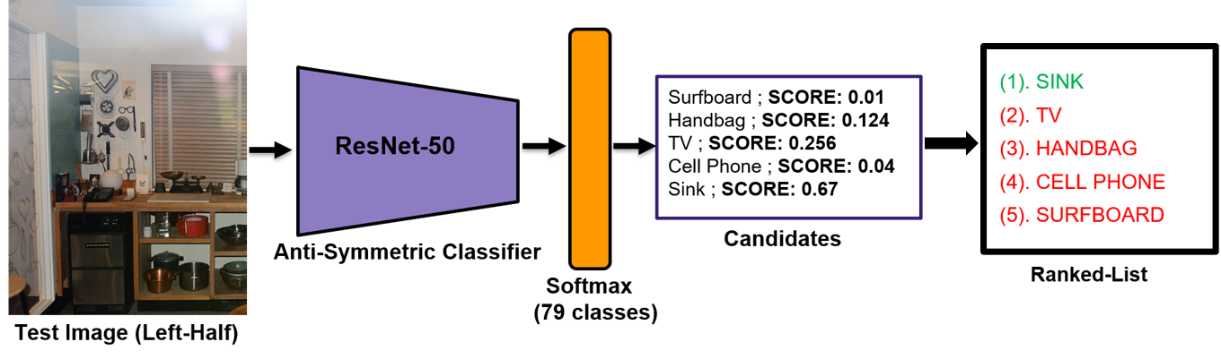
Testing
Our approach: End-to-end learning of visual context
Anti-symmetric classifier

Slide 14
Results
Baselines:
Random Chance
GIST feature descriptor + Multi-layer Perceptron
Symmetric Classifier [Standard CNN trained on Left-half images to predict left-half labels]
Methods | Rank-1 Accuracy
Random Chance | 20%
GIST | 41.95%
Symmetric | 58.73%
Anti-Symmetric | 70.71%

Slide 15
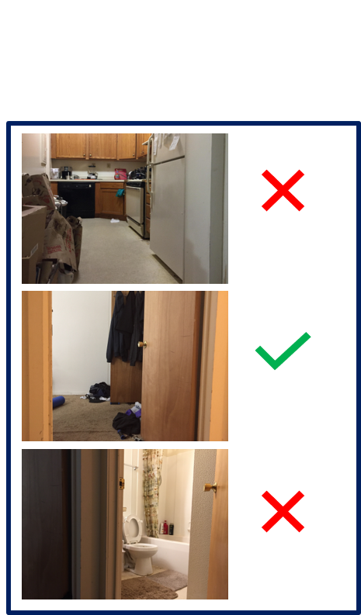
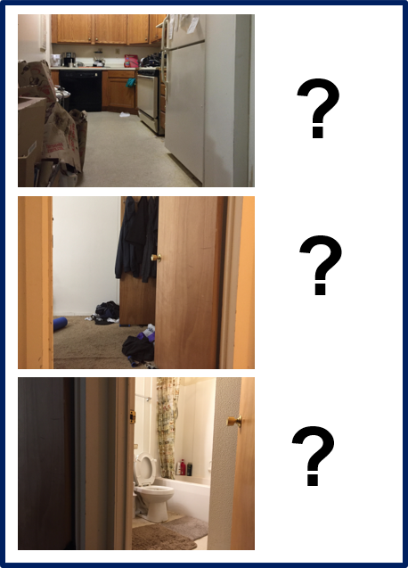
Half&Half Label-to-Image
Asks the question: “Where’s the best place to find a given object?”
BED?

Slide 16
Half&Half Label-to-Image
Asks the question: “Where’s the best place to find a given object?”
BED

Slide 17
Summary
If we want to imbue agents with “common sense”, they need to be able to make simple inferences about where things are likely to be, even if they can’t be seen. The Half&Half benchmarks are an attempt to formalize these notions and provide a testbed for measuring the performance on these tasks.
Coming soon to an arXiv near you!

